Slide 1
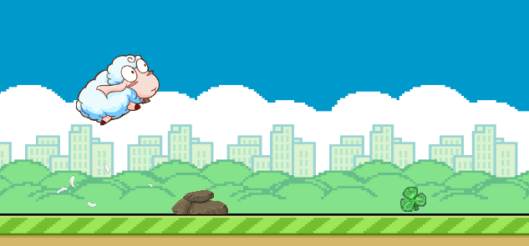
RUnSHEEP
Game design and implementation

Slide 2
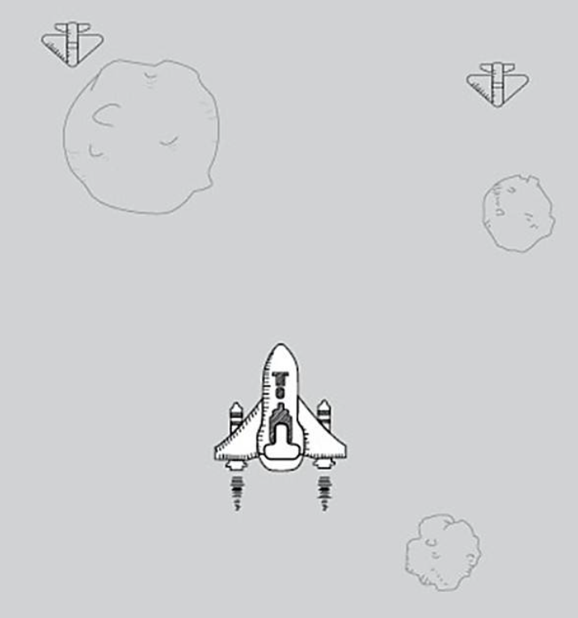
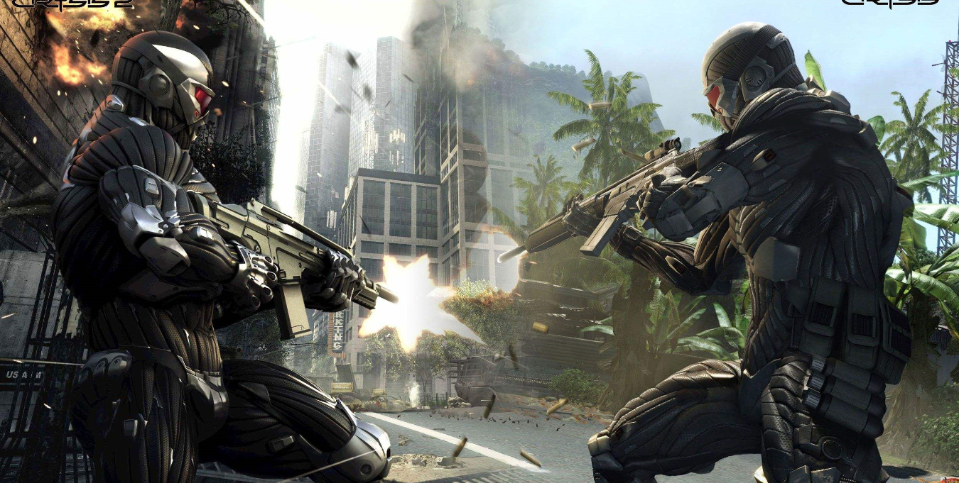
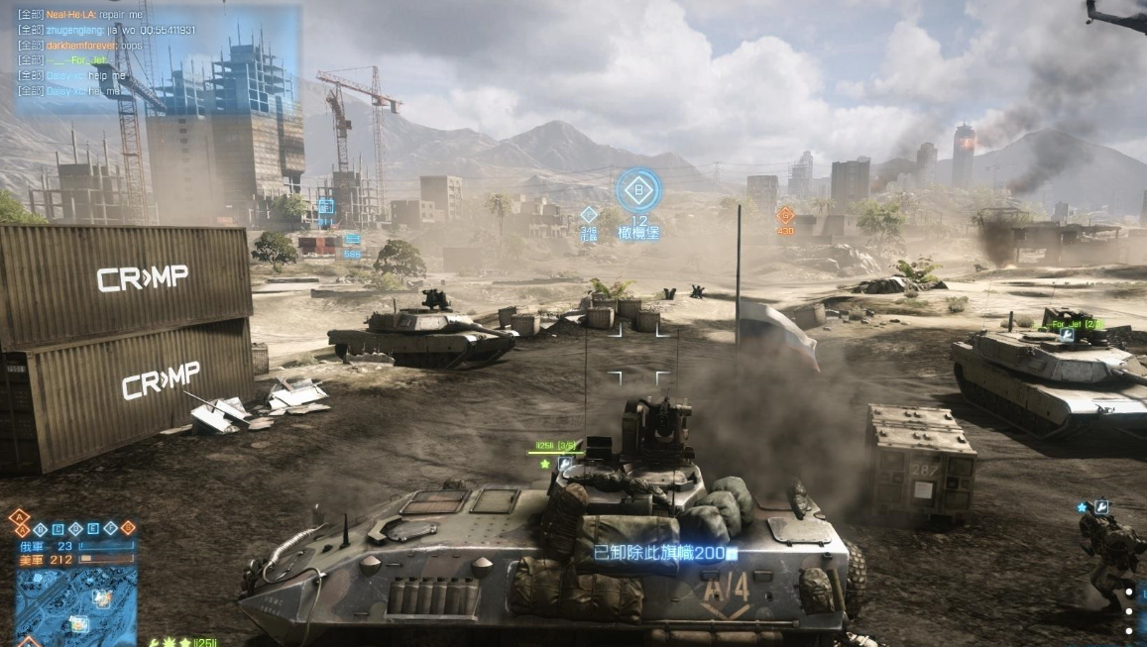
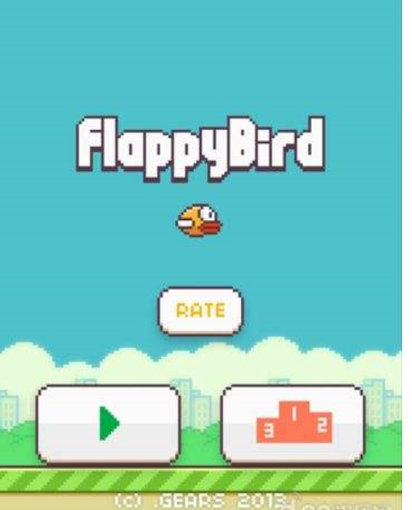
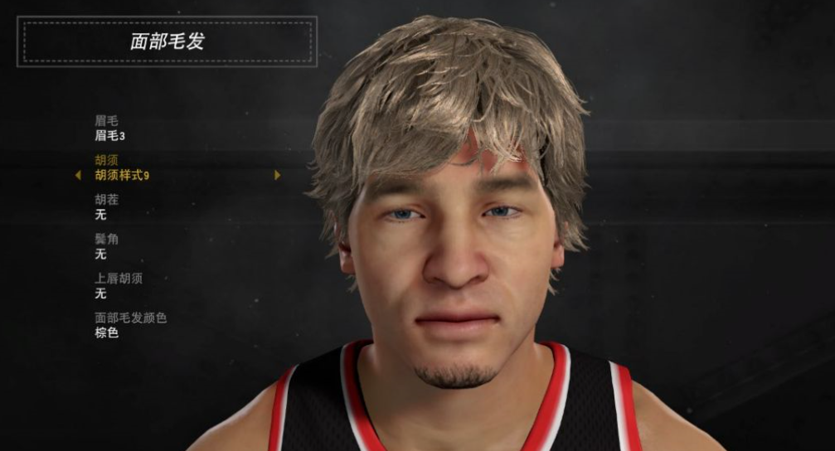
Design
Background
Large game
Like 2ksports, Battlefield, Crysis
Mini game
Flappy Bird, hit the plane on Wechat

Slide 3
Design
Design concept
light fun and no pressure
For the large games, it often bring strong sensory stimulation
low cost
Mini game the player has natural advantages in development, download and install, learning cost, etc.

Slide 4
Design
Selling Point
easy
Make people use it for fun easily. The cost of studying is zero
funny
playability
make sure the players do not want to stop!

Slide 5
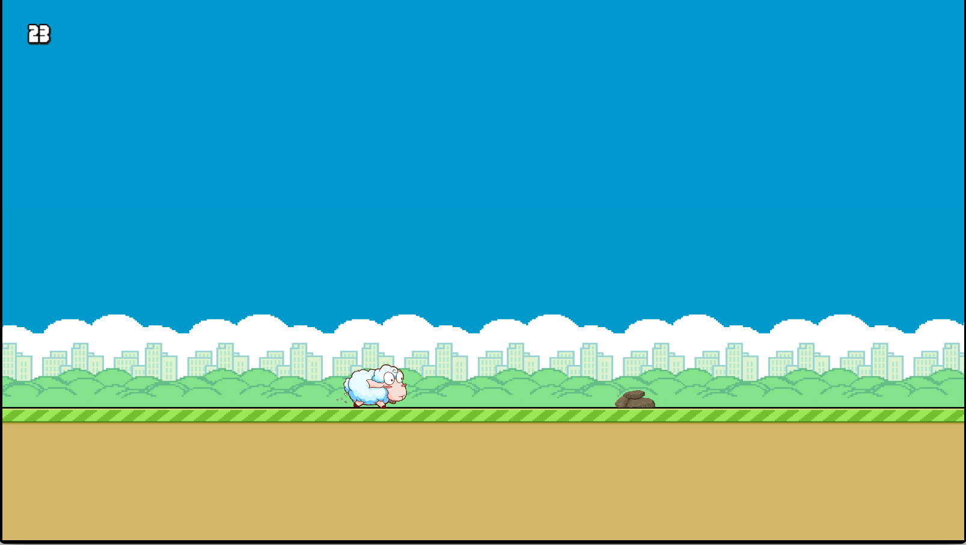
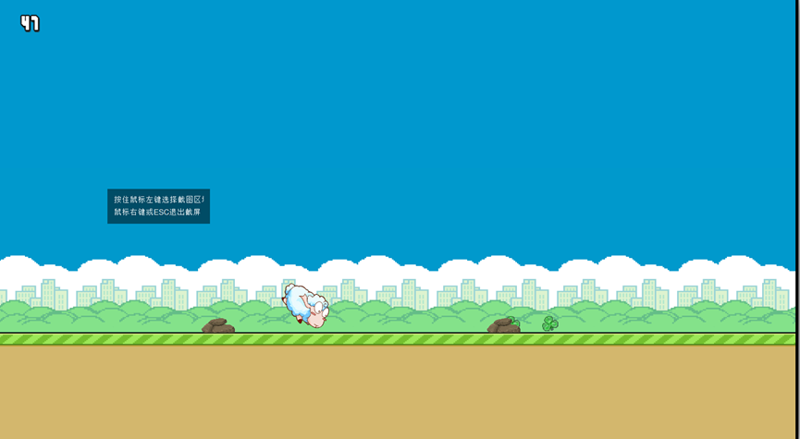
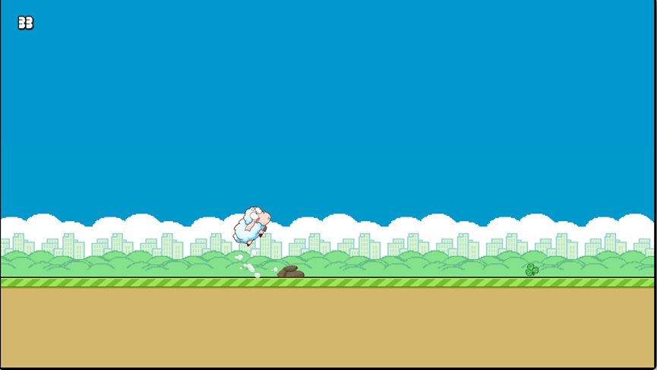
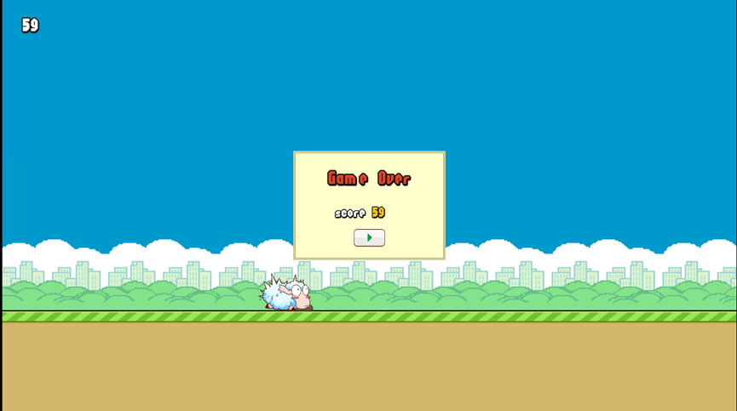
Design
The demo

Slide 6
Design
The future and the commerce plan
We will make it Into a mobile application, add embedded advertisements
The game can run in the browser through computers and mobile phones

Slide 7
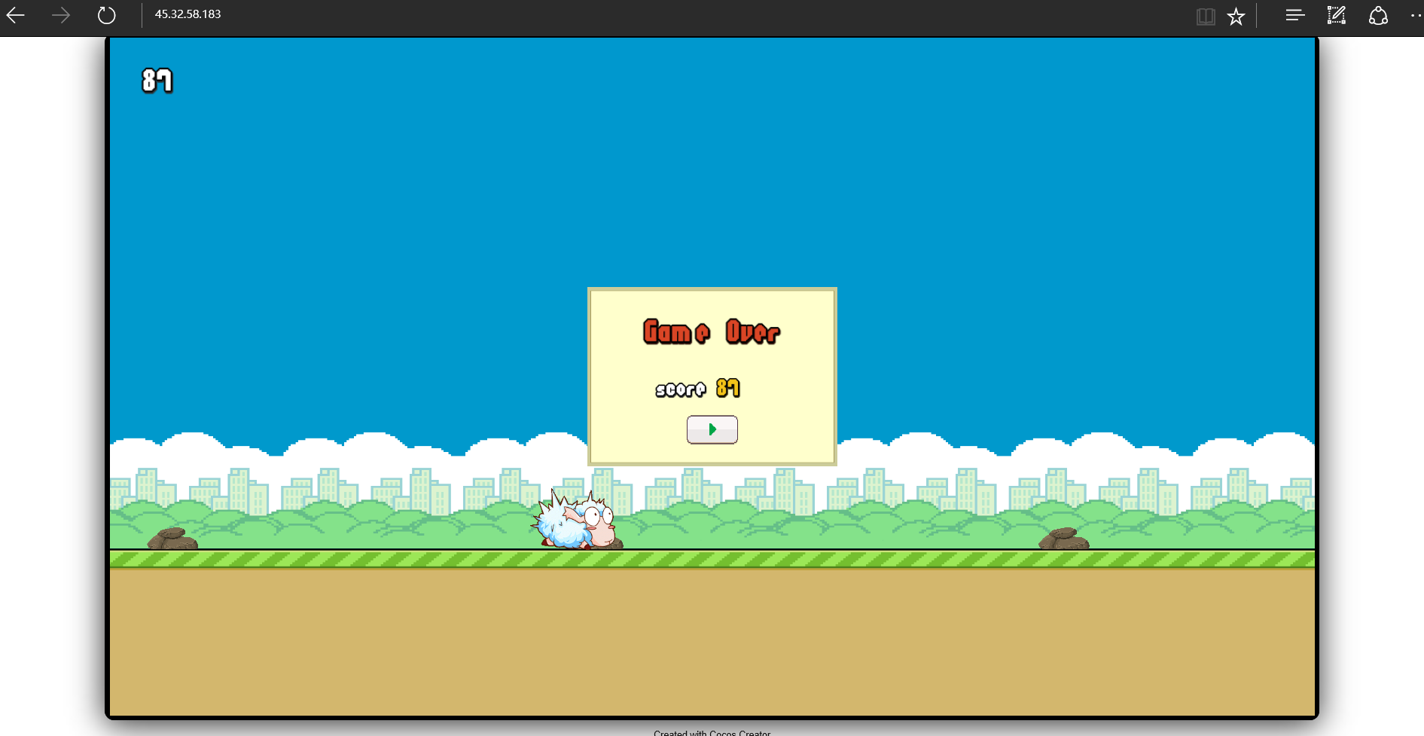
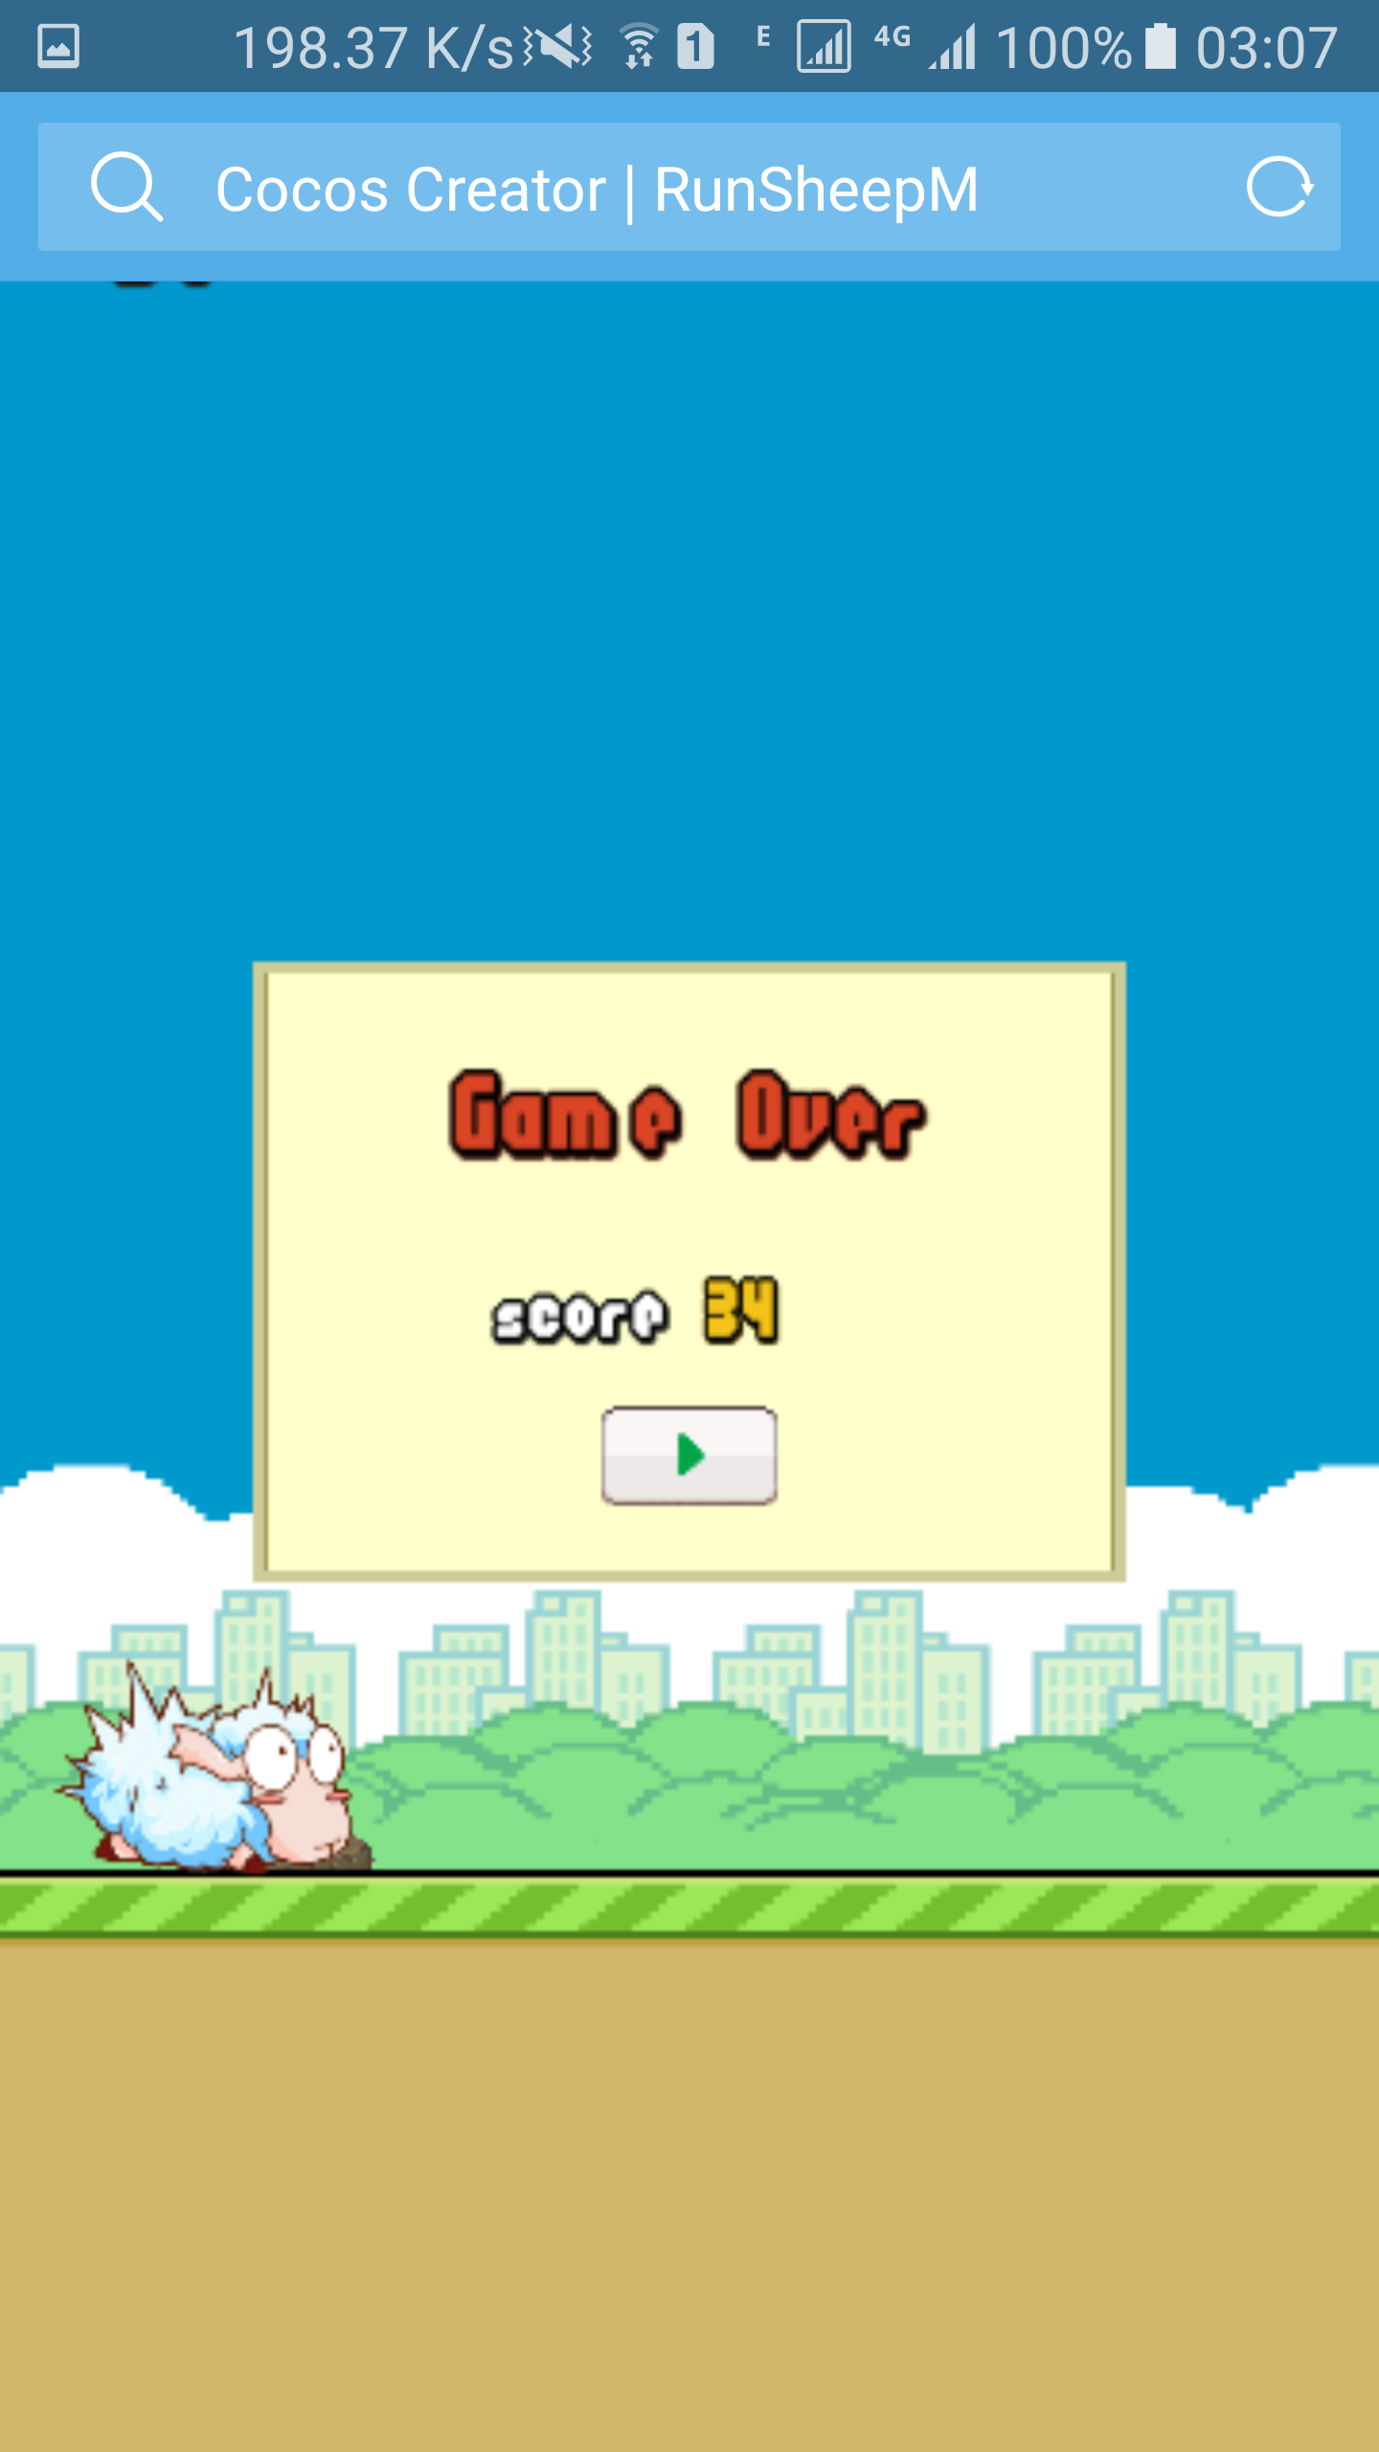
Implementation
Pc:45.32.58.183
Mobile phone:45.32.58.183/m/index.html

Slide 8
Thank you !

